Slide 1
SUPPLY CHAIN ANALYTICS
CAPSTONE PROJECT
RUPALI PAL
YASASVI CHAGANTI
KS JAYAPRAKASH

Slide 2
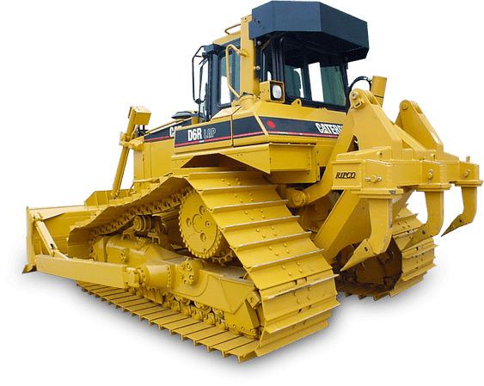
CONTENTS
Objective
Background
Problem Statement
Datasets & Methodologies
Key Findings
Recommendations & Insights

Slide 3
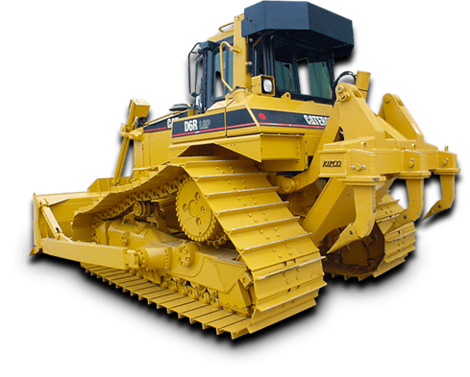
OBJECTIVE
Develop an advanced real-time monitoring system and gain insights on important metrics related to production inefficiencies.
Determine the highest-performing and lowest-performing equipment within the mining operation.
Assess the payload carrying capacity of the equipment and enhance understanding in this area.

Slide 4
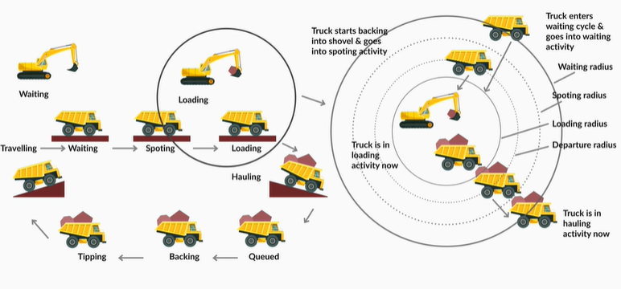
BACKGROUND
The client is facing serious problems with their manufacturing processes, which is causing them to lose the trust of their consumers.
They are also finding it difficult to meet their customers' needs even if there isn't a surge in demand.
They must put in place a comprehensive real-time monitoring system to efficiently track and control their manufacturing activities in order to handle these problems
.

Slide 5
PROBLEM STATEMENT
Understand the problem faced by the mine and take an understanding of the data shared by the client.
Since the client is not very tech-savvy, you need to prepare a cleaned dataset using the dataset provided by him.
Analyze the data using the MySQL Workbench 8.0 and prepare a live tracking system using some set of dashboards using either Tableau or Power BI.

Slide 6

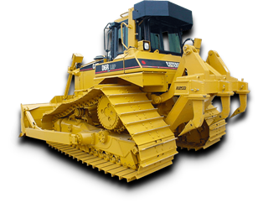
DATASETS & METHODOLOGY
We have 3 sets of data to perform Analysis on:
Cycle Data
Location data
Delay Data
METHODOLOGY– Loaded the tables in MySQL Workbench and imputed the null values of the columns taking either the Median or the Average of the column, created stored procedures and loaded the data in Tableau and created the dashboards to get insights.

Slide 7
DASHBOARDS
Executive Dashboard: Level 1 Dashboard with all the details in one.
Equipment Level Production
Efficiency, Accuracy and Quality of the Equipments
Key Metrics of Lowest Performing Equipments
Top Performing Equipments

Slide 8
WHAT IS OPEN PIT MINING?
Open-pit mining is a surface mining technique of extracting rocks or minerals from open pit in the ground also known as a quarry.
Open-pit mines are employed in situations where important deposits are located close to the surface, the surface layer covering them is thin, or the material of interest is structurally unsuitable for tunneling (such as in the case of gravel, sand, and cinder).
Bauxite, clay, coal, copper, coquina, diamonds, gravel, and stone (stone is unconsolidated material; granite, gritstone, gypsum, limestone, marble), as well as metal ores like copper, iron, gold, silver, molybdenum, uranium, and phosphate, can all be extracted using this particular technique.

Slide 9
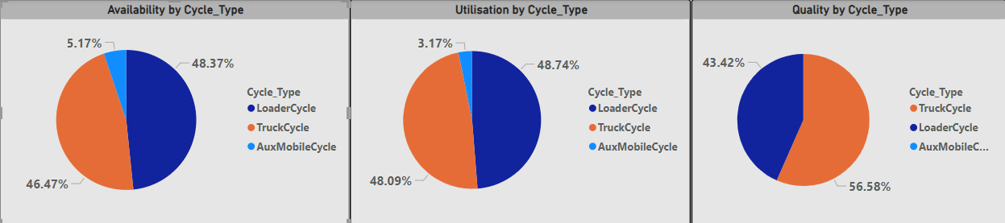
Overall Efficacy of the Equipment
The pie charts above demonstrate that, in comparison to truck cycle and aux mobile cycle, loader cycle utilization and availability are higher (about 48%).
Truck Cycle is outperforming Loader Cycle in terms of quality.
The performance of Aux Mobile is lowest across the board.

Slide 10
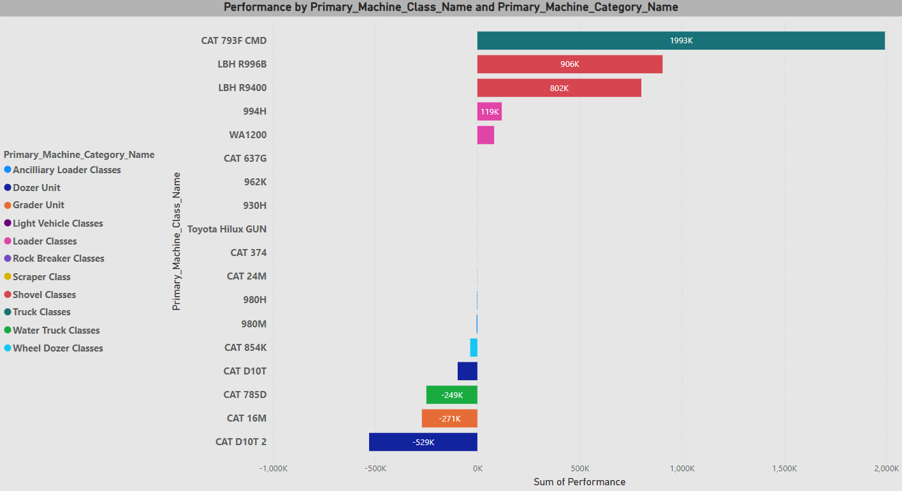
Categorical Performance
CAT 793FCMD - Primary Class truck is the top performer in the truck class.
The Dozer Class model, CAT D10T 2, has the lowest performance.

Slide 11
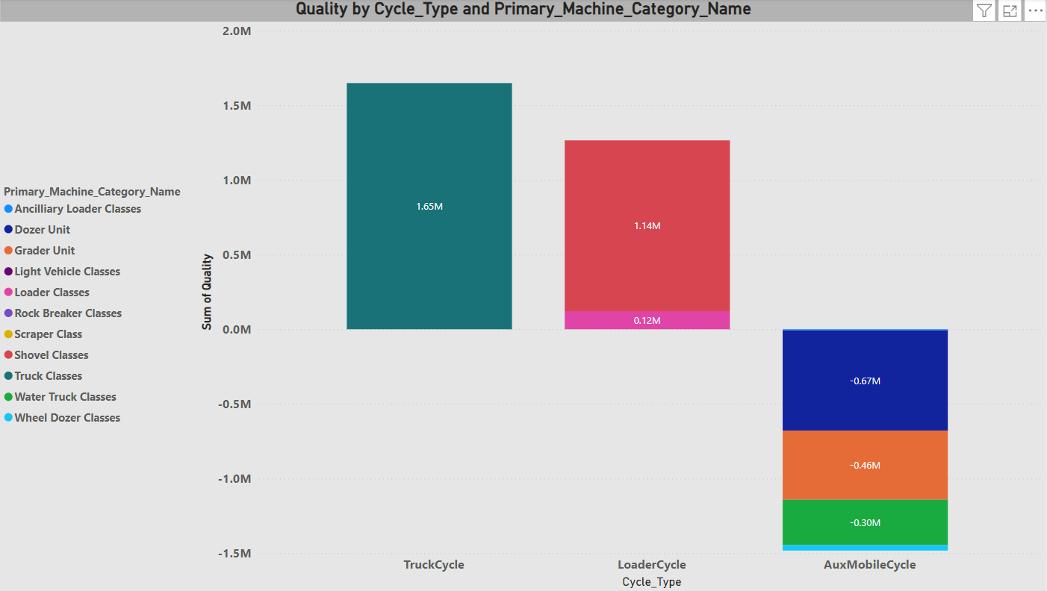
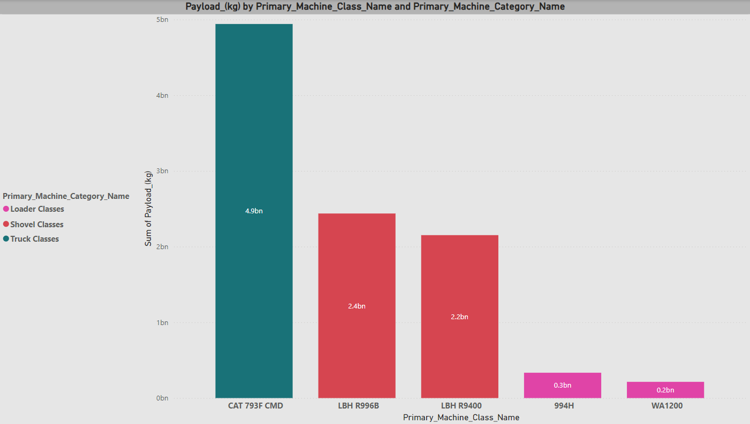
Payload Capacity and Quality of each Class
CAT 793F CMD has the Highest Payload Capacity and it belong to Truck Class.
WA1200 has the lowest Payload capacity and it belongs to Shovel Class.
Truck Class has the Highest Quality and Wheel Dozer class has the Lowest Quality

Slide 12
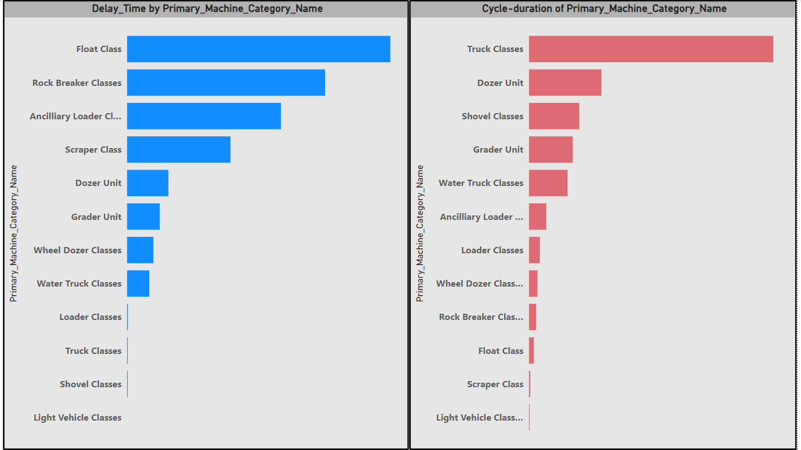
Accuracy of each class
Truck Classes have longer cycles than Float Classes, while Float Class has the longest delays.

Slide 13
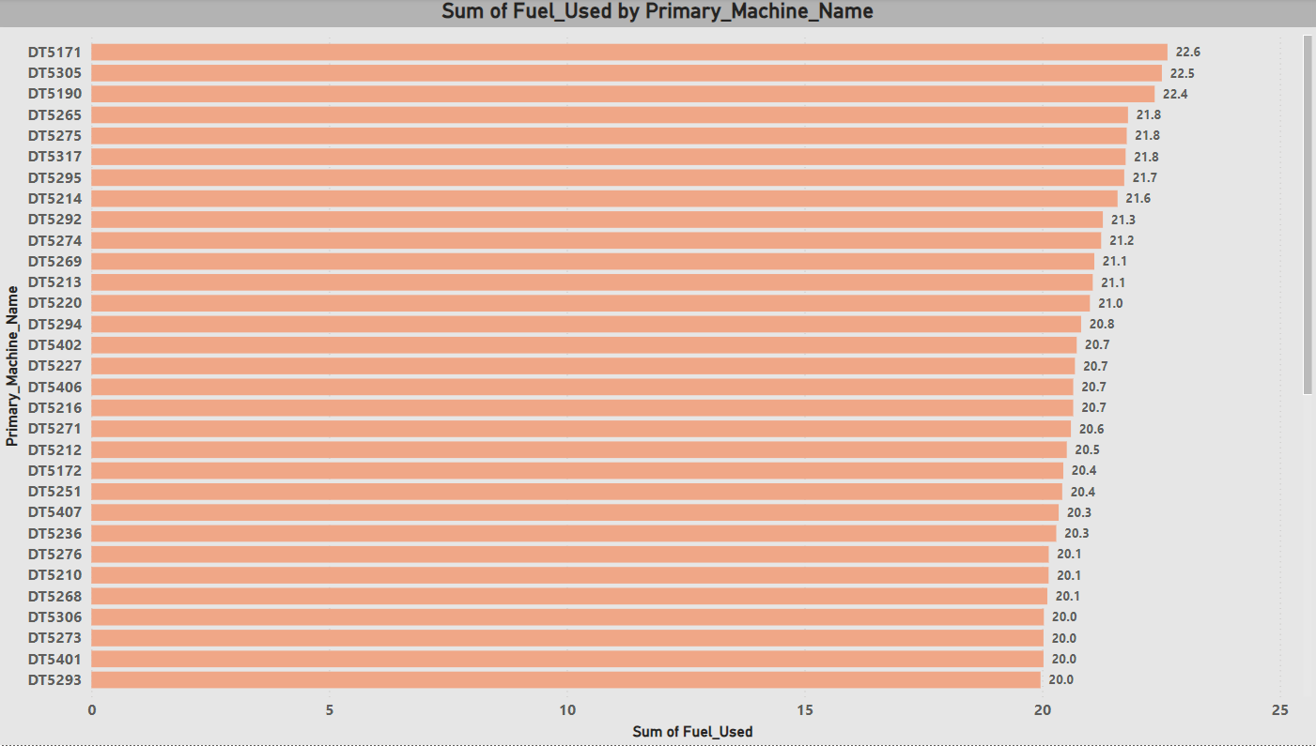
Fuel Usage
DT5171 has the highest fuel usage, DT5162 has the lowest fuel usage.

Slide 14
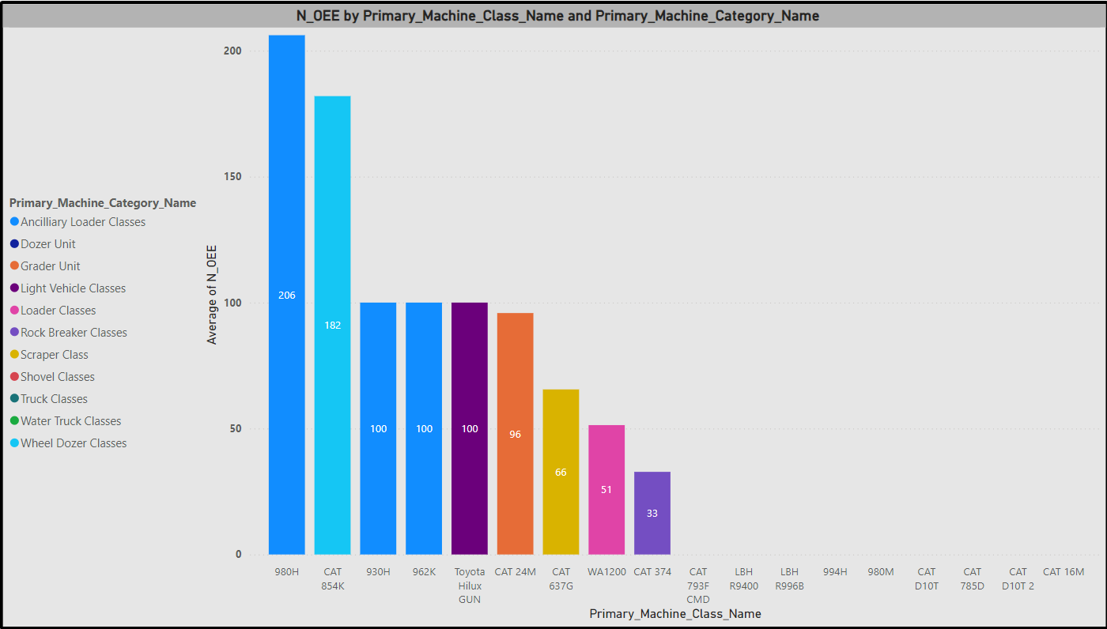
OEE Findings
OEE = Availability * Performance * Quality
Ancillary Loader Class has the Highest OEE

Slide 15
RECOMMENDATIONS
Equipment that are less productive should be replaced by the more productive ones from the same class
Trucks with a higher payload and mileage should be preferred considering the fuel costs
Lesser quality equipment have a higher downtime and should be replaced
There should be on field maintenance to reduce the maintenance time
We should increase the number of Loaders to reduce the loading and waiting time.

Slide 16
Video Demonstration Link
https://drive.google.com/file/d/1UFUhYrKQ6HbMokjjQEGA_b8Z3exYAJUg/view

Slide 17
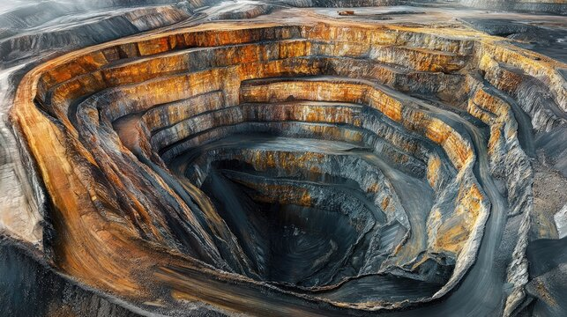

THANK YOU

